Slide 1



Do not edit
How to change the design
Join at slido.com
#2483105
Presenting with animations, GIFs or speaker notes? Enable our Chrome extension
Notes:
📣 This is Slido interaction slide, please don't delete it.
✅ Click on 'Present with Slido' and the joining instructions will appear when you get to this slide.

Slide 2
Exploratory Data Analysis (EDA) III
⚠️(Instructor) Reminder to start Askademia!
LECTURE 4
Grouped operations and missing data
Data 100/Data 200, Fall 2026 @ UC Berkeley
Ramesh Sridharan and Jeremy Sanchez
Content credit: Acknowledgments

Slide 3
Announcements!
Homework 1 is released, due Friday 9/11 at 11:59pm
Homework Grading Clarification
Homework 00: Graded on completion/effort
Homework 1 & Onward:
  Autograded questions: Based on autograder score (all tests are now public)
  Written/manual questions: Graded on completion and good-faith effort
Prerequisite Quiz: Tuesday 9/08 (today!) through Thursday 9/10
Notes:
Slightly formalized in wording, but still mostly the same:
Ask a Question
Obtain Data
Understand the Data
Understand the World

Slide 4
Fundamental Operations So Far (and what we’ll work on today)!
View a preview of a dataframe.
Select specific columns.
Create new columns.
Filter to specific rows.
Order the data by the values in a column.
Calculate summary statistics for one or more columns.
Visualize 1D (one dimensional) data with a boxplot or histogram.
Visualize 2D data with a scatterplot or lineplot.
Group by some variable, and then do something (most often, aggregate).
English: "For each unique value of COLUMN(S), do SOMETHING."
🧙 Grouping and visualizing → Majority of EDA with tabular data!

Slide 5
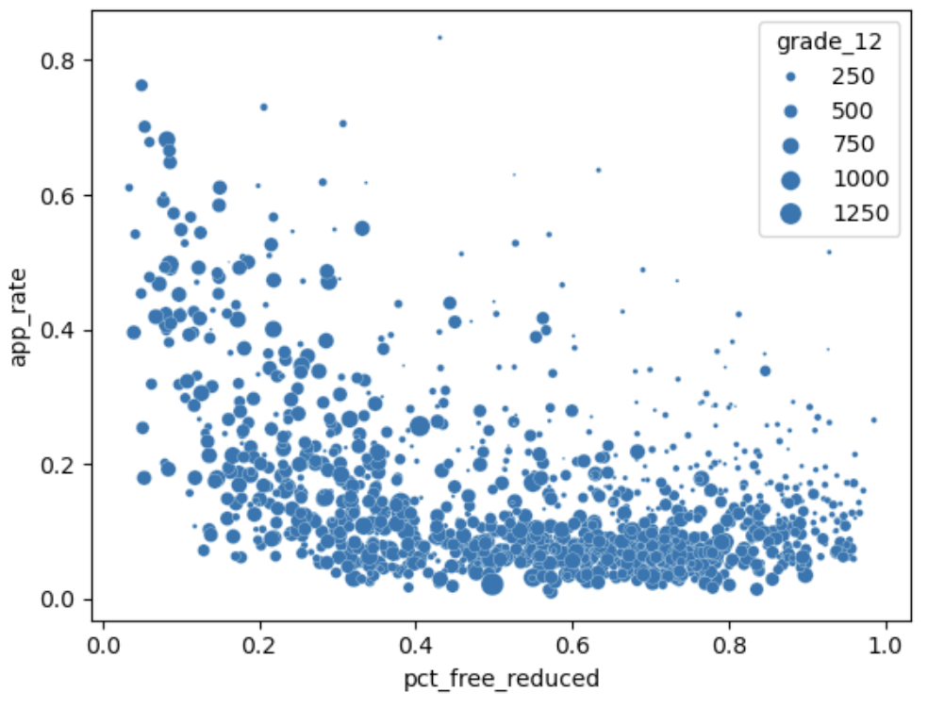
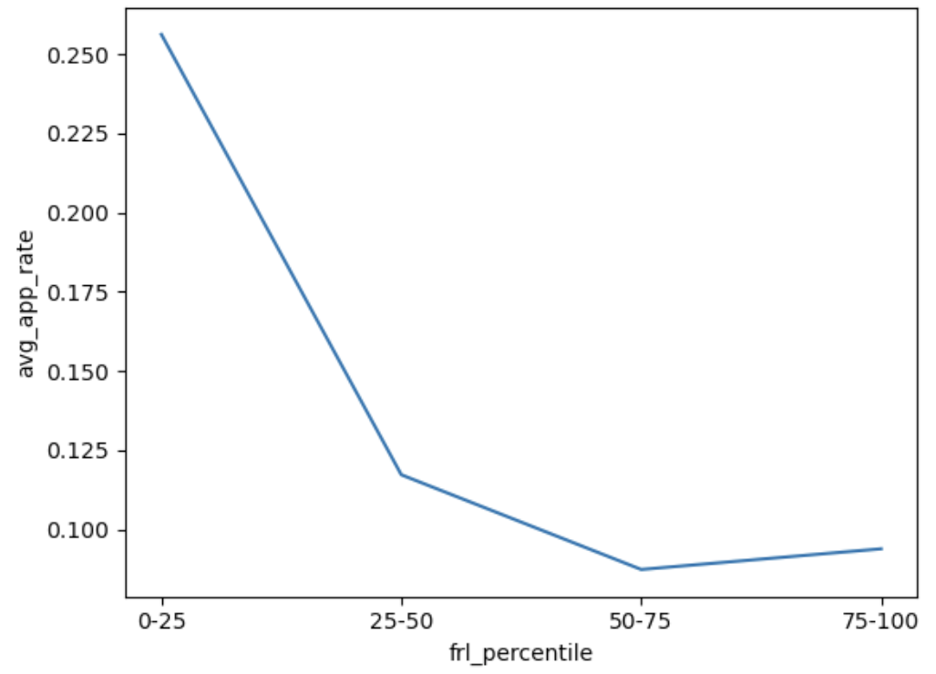
Last time: Summarizing patterns
Depending on the audience, we may or may not want to show every data point.
A
B
Another nice option: Make the points nearly transparent and overlay a bold curve on top!
Note: The 0–25 frl_percentile bin consists of the 25% of schools with the lowest values of pct_free_reduced.
It is not all schools where 0 < pct_free_reduced < 0.25.

Slide 6
Writing visualization code with Seaborn
Plotting function goes here: scatterplot, lineplot, histplot, etc.
Extra formatting arguments go here: this is look-it-up or ask-an-LLM territory!
sns.scatterplot(df_new, x='pct_frl', y='app_rate', size='grade_12', ...)
Your dataframe goes here
Columns with information for x, y, color, size, etc. go here

Slide 7
Last time: Tidy data
What data is needed to make this plot?
Tidy data: Each row represents one data point in the plot.
There are 4 points in the plot.
So, 4 rows are needed.
Each point has 2 features: frl_percentile and avg_app_rate.
So, we need 2 columns.

Slide 8
Last time: Tidy data
frl_percentile | avg_app_rate
0–25 | 0.26
25–50 | 0.12
50–75 | 0.087
75–100 | 0.094
How do we generate this data?

Slide 9
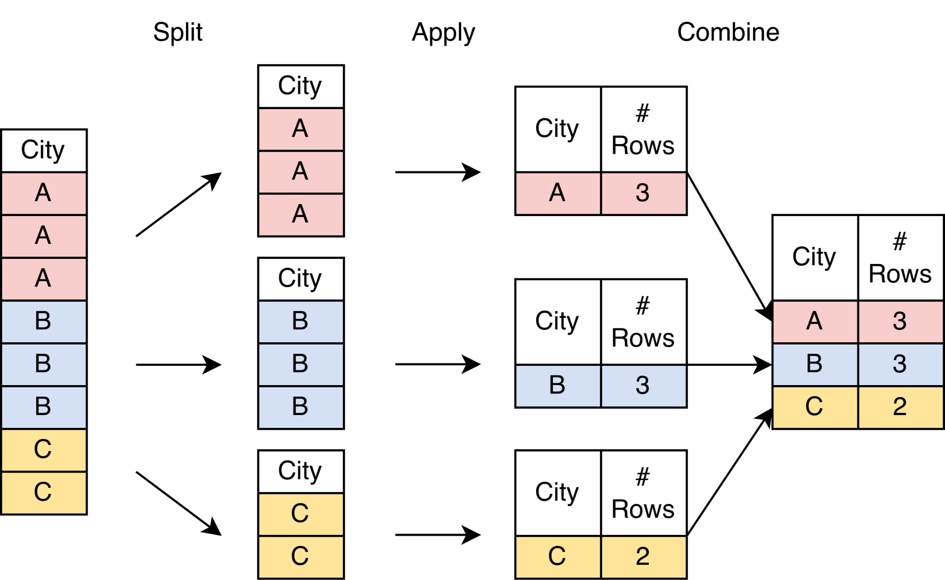
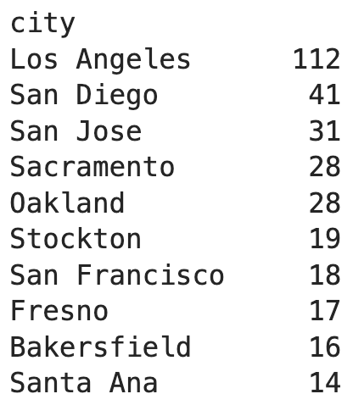
Split-Apply-Combine Paradigm
Step 1: Split
(by city)
Step 2: Apply
(count rows)
Step 3: Combine
"For each unique value of city, count the number of rows."

Slide 10
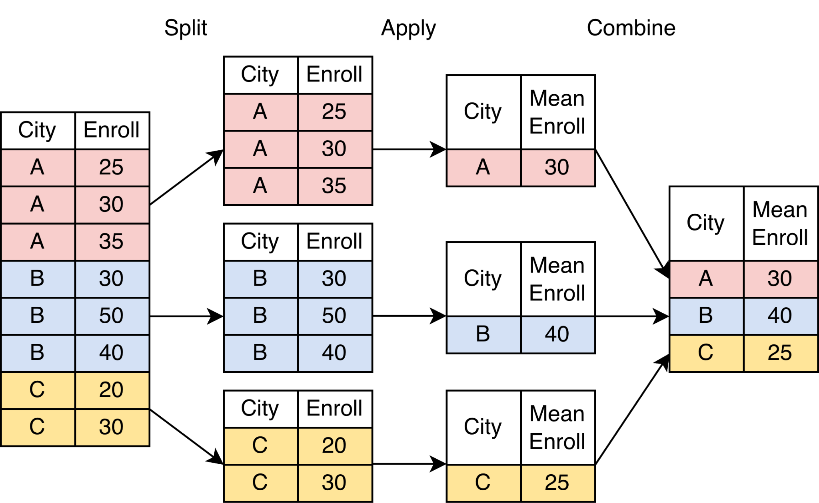
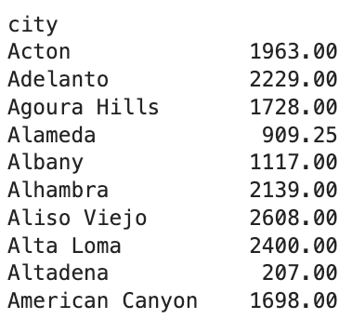
Split-Apply-Combine Paradigm
Step 1: Split
(by city)
Step 2: Apply
(average tot_enrolled)
Step 3: Combine
Josh grew up here!
One big high school.
"For each unique value of city, compute the mean # of students enrolled across its schools."

Slide 11
Split-apply-combine practice
For each of the following scenarios, write an analysis statement in the form "For each…".
You can make up any column name you think is appropriate for the dataset.

Slide 12

Do not edit
How to change the design
Same admissions dataset as before. Which counties have the most schools? Write an analysis plan starting with "For each…".
Presenting with animations, GIFs or speaker notes? Enable our Chrome extension
Notes:
📣 This is Slido interaction slide, please don't delete it.
✅ Click on 'Present with Slido' and the poll will launch automatically when you get to this slide.

Slide 13
Slido 1
1. Same admissions dataset as before. Which counties have the most schools?
"For each unique value of county, count the number of rows."
"Sort the data in descending order of # of rows."
… | county | …
… | County A | …
… | County B | …
… | County B | …
… | County A | …
… | County C | …
… | County B | …
county | n_schools
County A | 2
County B | 3
County C | 1
county | n_schools
County B | 3
County A | 2
County C | 1
The other columns do not matter!
Polars Code | SQL Query
admissions.group_by('county').len().sort('len',descending=True) OR admissions.group_by('county').agg(num_schools=pl.len()).sort('num_schools',descending=True) | SELECT county, COUNT(*) as n_schools FROM admissions GROUP BY county

Slide 14
Do not edit
How to change the design
Transaction dataset. How much did each customer spend every day?
Presenting with animations, GIFs or speaker notes? Enable our Chrome extension
Notes:
📣 This is Slido interaction slide, please don't delete it.
✅ Click on 'Present with Slido' and the poll will launch automatically when you get to this slide.

Slide 15
Slido 5
5. Transaction dataset. Which customer spent the most money on each day?
"For each unique combination of date and customer_id, sum up the cost column."
"Then, sort the resulting dataframe in decreasing order of summed cost."
"Finally, for each unique date, grab the first row."
Repeated grouping!
customer_id | date | sum_cost
A | 6/1 | 10
B | 6/1 | 60
A | 6/2 | 120
B | 6/2 | 30
customer_id | date | sum_cost
A | 6/2 | 120
B | 6/1 | 60
B | 6/2 | 30
A | 6/1 | 10
customer_id | date | sum_cost
A | 6/2 | 120
B | 6/1 | 60
B | 6/2 | 30
A | 6/1 | 10
Result from previous Slido.
Groups have been reset and redefined to just date.

Slide 16
Slido 2
2. Dataset where each row is a transaction. Which customers spend the most money?
"For each customer_id, sum up the cost column."
"Sort the data in descending order of summed cost."
… | customer_id | cost | …
… | A | 10 | …
… | B | 50 | …
… | B | 10 | …
… | A | 20 | …
… | C | 100 | …
… | B | 30 | …
customer_id | sum_cost
A | 30
B | 90
C | 100
customer_id | sum_cost
C | 100
B | 90
A | 30
Polars Code | SQL Query
transactions.group_by('customer_id').sum().sort('sum_cost',descending=True) OR transactions.group_by('customer_id').agg(total_cost= pl.col('cost').sum()).sort('total_cost', descending=True) | SELECT customer_id, SUM(cost) as sum_cost FROM transactions GROUP BY customer_id ORDER BY sum_cost DESC

Slide 17
Do not edit
How to change the design
Admissions dataset. In each county, which two schools have the most admits to UC Berkeley?
Presenting with animations, GIFs or speaker notes? Enable our Chrome extension
Notes:
📣 This is Slido interaction slide, please don't delete it.
✅ Click on 'Present with Slido' and the poll will launch automatically when you get to this slide.

Slide 18
Slido 3
3. Admissions dataset. In each county, which two schools have the most admits?
"First, sort the entire dataframe in decreasing order of the admit column."
"Then, for each unique value of county, grab the first two rows starting from the top."
… | county | admitted | …
… | County A | 8 | …
… | County B | 10 | …
… | County B | 2 | …
… | County A | 3 | …
… | County A | 7 | …
… | County B | 5 | …
… | county | admitted | …
… | County A | 8 | …
… | County A | 7 | …
… | County B | 10 | …
… | County B | 5 | …
… | County A | 3 | …
… | County B | 2 | …
Notice that all columns are kept.
Polars Code | SQL Query
admissions.sort('admitted', descending=True).group_by('county').head(2) | SELECT * FROM df GROUP BY county ORDER BY admitted DESC LIMIT 2

Slide 19
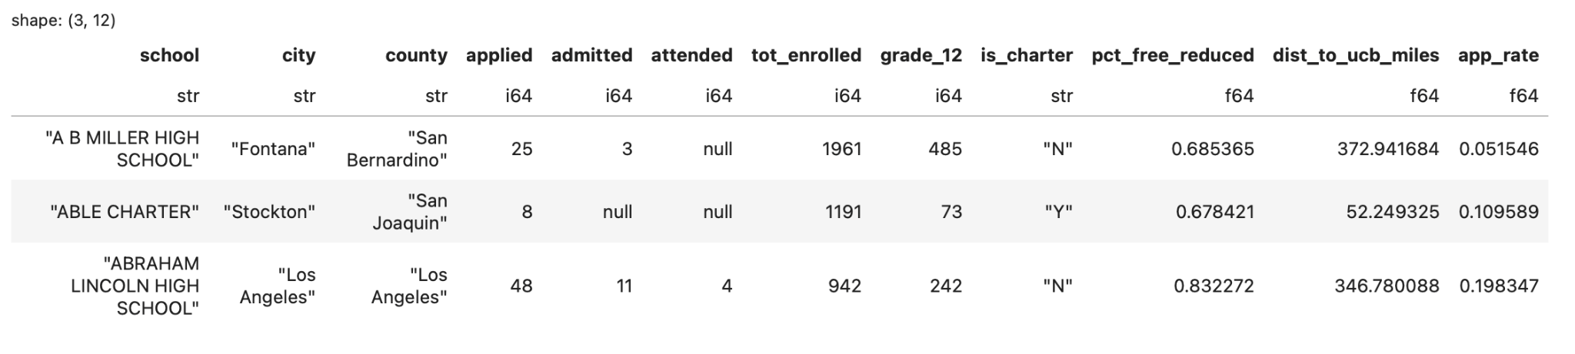
More on df.head(n)
df.head(n) is an easy way to peek at the first n rows of a DataFrame.
Also useful for grabbing the first n rows of each group in a grouped DataFrame.
Polars Code | SQL Query
admissions.head(3) | SELECT * FROM admissions LIMIT 3

Slide 20
Do not edit
How to change the design
Dataset where each row is a transaction. Which customers spend the most money?
Presenting with animations, GIFs or speaker notes? Enable our Chrome extension
Notes:
📣 This is Slido interaction slide, please don't delete it.
✅ Click on 'Present with Slido' and the poll will launch automatically when you get to this slide.

Slide 21
Slido 4
4. Dataset where each row is a transaction. How much did each customer spend every day?
"For each unique combination of date and customer_id, sum up the cost column."
We can group by more than one column!
… | customer_id | date | cost | …
… | A | 6/1 | 10 | …
… | B | 6/1 | 50 | …
… | B | 6/1 | 10 | …
… | A | 6/2 | 20 | …
… | A | 6/2 | 100 | …
… | B | 6/2 | 30 | …
customer_id | date | sum_cost
A | 6/1 | 10
B | 6/1 | 60
A | 6/2 | 120
B | 6/2 | 30
Groups defined by a combination of two columns.
Polars Code | SQL Query
transactions.group_by('customer_id','date').sum() | SELECT customer_id, date, SUM(cost) as sum_cost FROM transactions GROUP BY date, customer_id

Slide 22
Do not edit
How to change the design
Transaction dataset. Which customer spent the most money on each day?
Presenting with animations, GIFs or speaker notes? Enable our Chrome extension
Notes:
📣 This is Slido interaction slide, please don't delete it.
✅ Click on 'Present with Slido' and the poll will launch automatically when you get to this slide.

Slide 23
Slido 5
5. Transaction dataset. Which customer spent the most money on each day?
"For each unique combination of date and customer_id, sum up the cost column."
"Then, sort the resulting dataframe in decreasing order of summed cost."
"Finally, for each unique date, grab the first row."
Polars Code | SQL Query
customers_2.group_by('customer_id','date').sum().sort('sum_cost',descending=True).group_by('date').head(1) | Beyond Data 100 coverage! Messier than you would expect.

Slide 24
Tidy data: Redux
frl_percentile | avg_app_rate
0–25 | 0.26
25–50 | 0.12
50–75 | 0.087
75–100 | 0.094
How do we generate this data?
Now we can describe how!

Slide 25
Do not edit
How to change the design
What's your first message to the LLM to help you construct this plot from the raw admissions data? Hint: We have our groups. How do we get to the groups? Be specific!
Presenting with animations, GIFs or speaker notes? Enable our Chrome extension
Notes:
📣 This is Slido interaction slide, please don't delete it.
✅ Click on 'Present with Slido' and the poll will launch automatically when you get to this slide.

Slide 26
Tidy data: Redux
frl_percentile | avg_app_rate
0–25 | 0.26
25–50 | 0.12
50–75 | 0.087
75–100 | 0.094
Compute the actual FRL percentile of each school.
Categorize each FRL percentile into four buckets: 0-25, 25-50, 50-75, and 75-100.
For each unique FRL bucket, compute the average application rate.
Understanding the definition of a percentile is useful.
But, the syntax for computing percentiles is not worth memorizing. Good LLM practice!

Slide 27
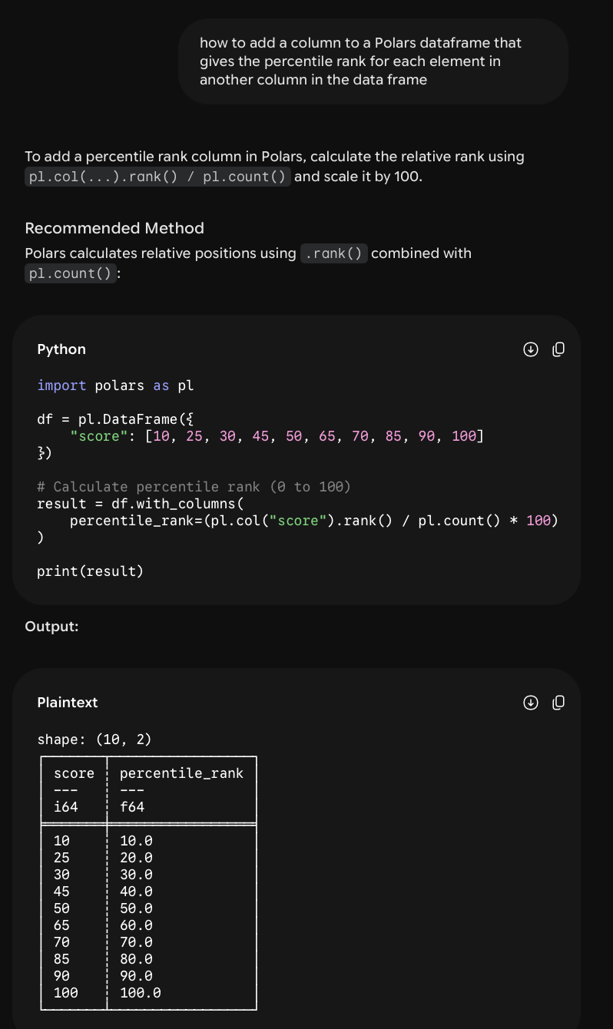

Slide 28
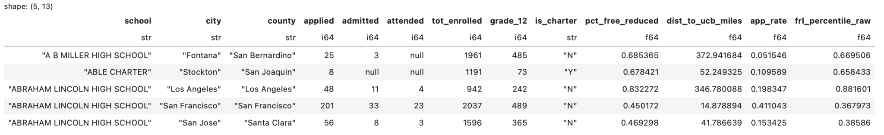
Adding a column with the FRL percentile
Does the new column pass the "sniff" test? In other words, does it look correct?
Polars Code
admissions = admissions.with_columns(frl_percentile_raw=pl.col('pct_free_reduced').rank()/pl.col('pct_free_reduced').count())

Slide 29
Do not edit
How to change the design
How do you compute the average admission rate for each frl_percentile?
Presenting with animations, GIFs or speaker notes? Enable our Chrome extension
Notes:
📣 This is Slido interaction slide, please don't delete it.
✅ Click on 'Present with Slido' and the poll will launch automatically when you get to this slide.

Slide 30
Tidy data: Redux
frl_percentile | avg_app_rate
0–25 | 0.26
25–50 | 0.12
50–75 | 0.087
75–100 | 0.094
Compute the FRL percentile of each school.
Sort each FRL percentile into four buckets: 0-25, 25-50, 50-75, and 75-100.
For each unique FRL bucket, compute the average application rate.

Slide 31
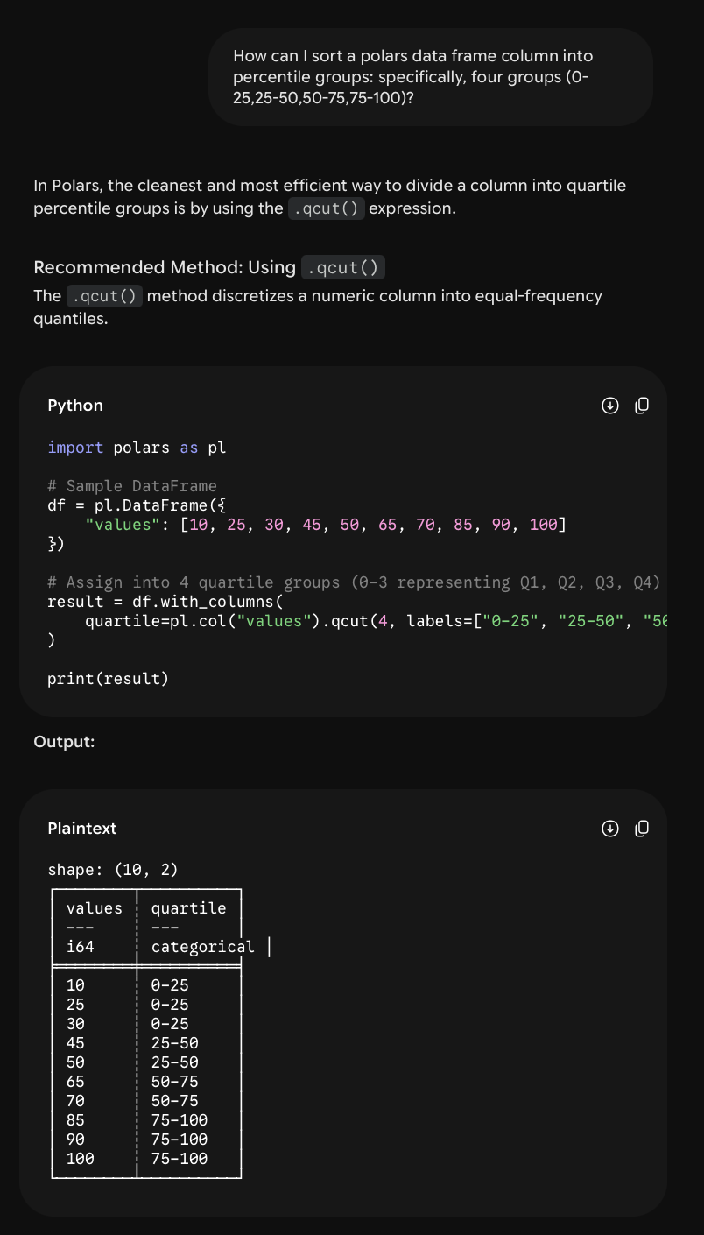

Slide 32
Tidy data: Redux
frl_percentile | avg_app_rate
0–25 | 0.26
25–50 | 0.12
50–75 | 0.087
75–100 | 0.094
Compute the FRL percentile of each school.
Sort each FRL percentile into four buckets: 0-25, 25-50, 50-75, and 75-100.
For each unique FRL bucket, compute the average application rate.

Slide 33
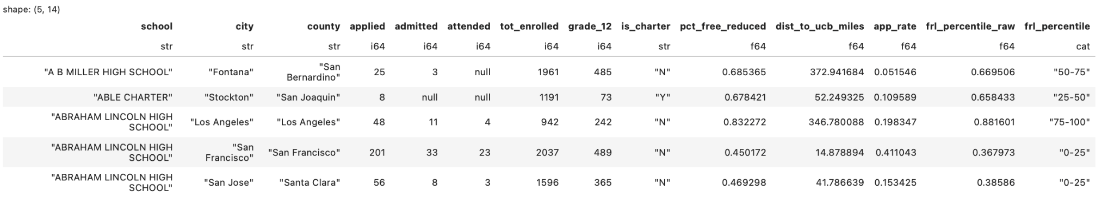
Group-wise averages
How do you compute the average application rate for each frl_percentile?

Slide 34
Do not edit
How to change the design
How should we compute the average application rate within each frl_percentile bucket?
Presenting with animations, GIFs or speaker notes? Enable our Chrome extension
Notes:
📣 This is Slido interaction slide, please don't delete it.
✅ Click on 'Present with Slido' and the poll will launch automatically when you get to this slide.

Slide 35
Group-wise averages
How do you compute the average application rate for each frl_percentile?
We should not compute the average of the app_rate column!
A school with 10 students probably should not have the same weight as one with 1,000 students.

Slide 36
Group-wise averages
How do you compute the average application rate for each frl_percentile?
For each frl_percentile group, we need total applicants / total possible applicants.
Sum up the applied column, sum up the grade_12 column, and divide!

Slide 37
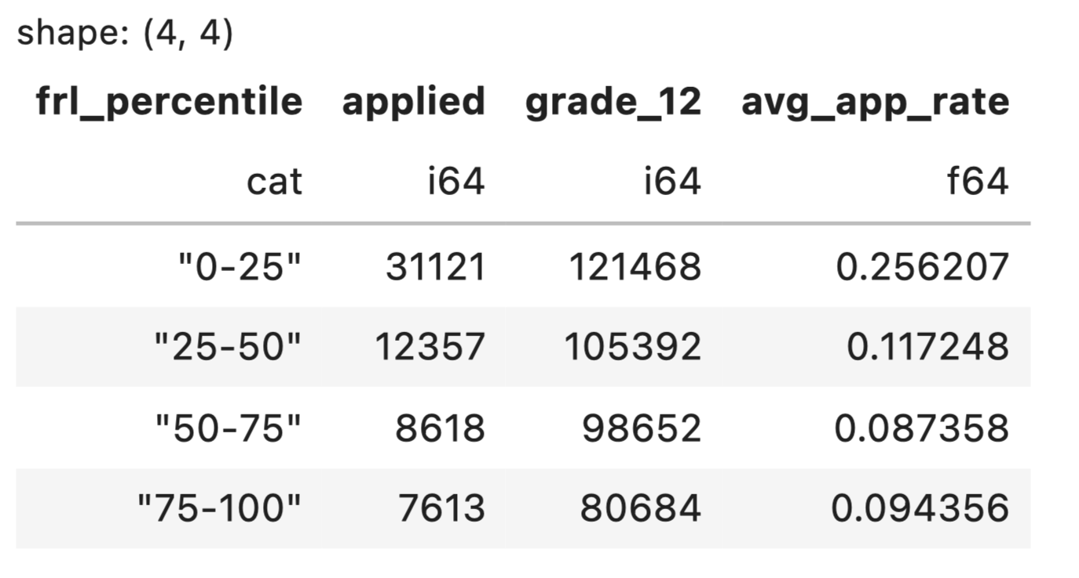
Group-wise averages
For each frl_percentile group, we need total applicants / total possible applicants.
Polars Code | SQL Query
df.group_by('frl_percentile').agg( applied= pl.col('applied').sum(), grade_12 = pl.col('grade_12').sum, avg_app_rate= pl.col('applied').sum()/pl.col('grade_12').sum()) | SELECT frl_percentile, SUM(applied) / SUM(grade_12) as avg_app_rate FROM admissions GROUP BY frl_percentile

Slide 38
Recreating our plot from earlier
Seaborn Code
sns.pointplot(uce_agged,x='frl_percentile',y='avg_app_rate',order=["0-25", "25-50", "50-75", "75-100"], marker='')

Slide 39
Group-wise averages
How do you compute the average admission rate for each frl_percentile?

Slide 40
Do not edit
How to change the design
How do you compute the average admission rate for each frl_percentile?
Presenting with animations, GIFs or speaker notes? Enable our Chrome extension
Notes:
📣 This is Slido interaction slide, please don't delete it.
✅ Click on 'Present with Slido' and the poll will launch automatically when you get to this slide.

Slide 41
Group-wise averages
How do you compute the average admission rate for each frl_percentile?
Naively, we could compute total admits / total applicants.
But, what about all those nulls in the admitted column?

Slide 42
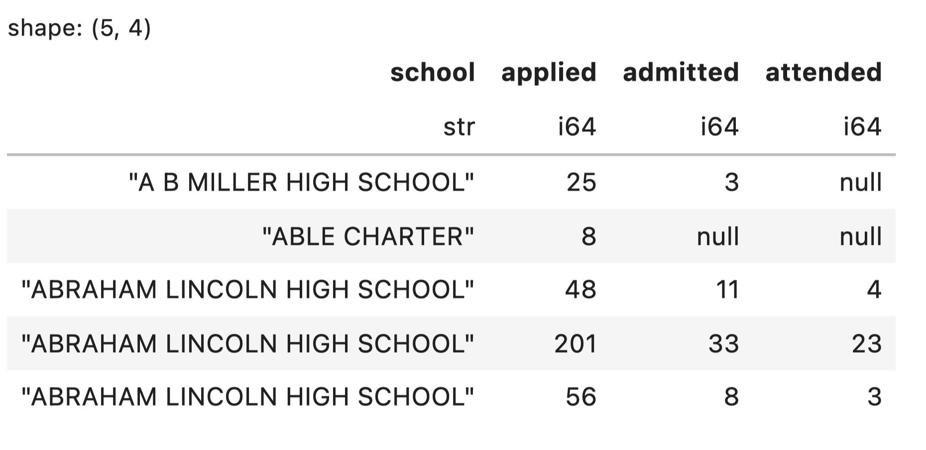
Handling missing data
Handling missing data is one of the most consequential tasks of a data scientist!
Here are several options:
Ignore the rows with admitted=null when computing admission rates.
Replace admitted=null with 0, the smallest possible value of the admitted column.
Replace admitted=null with 2, the largest possible value of the column.
Randomly select 0, 1, or 2.
We should not blindly choose one option and move on. What should we do?

Slide 43
The PCS Framework
The Predictability, Computability, and Stability (PCS) framework was developed by Bin Yu (UC Berkeley!) and others for producing trustworthy data analyses.
Predictability: Are the outputs of my analysis consistent with reality/domain knowledge?
[ We've been doing these reality checks a lot already! ]
Computability: Are my results generated from reproducible code?
[ In Data 100, we get computability "for free" when we use a Jupyter Notebook. ]
Stability: How sensitive is the analysis to realistic changes in its inputted data or decisions?
Example stability check: Does our analysis change based on our missing data approach?

Slide 44
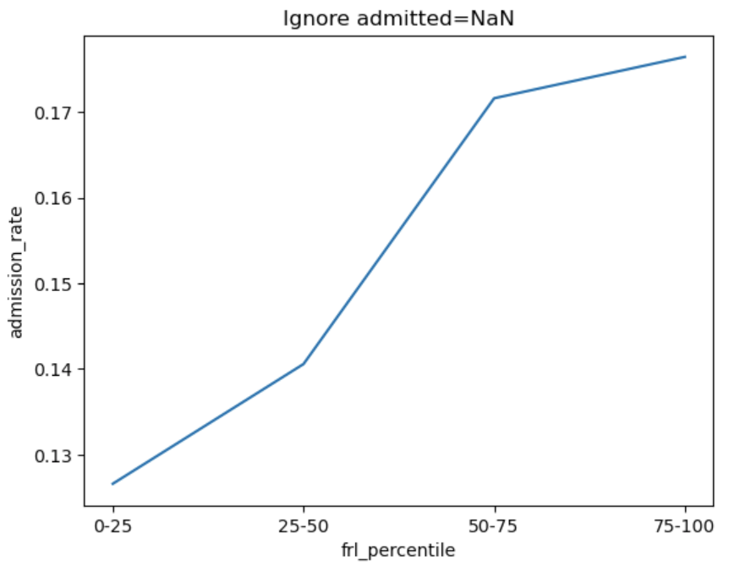
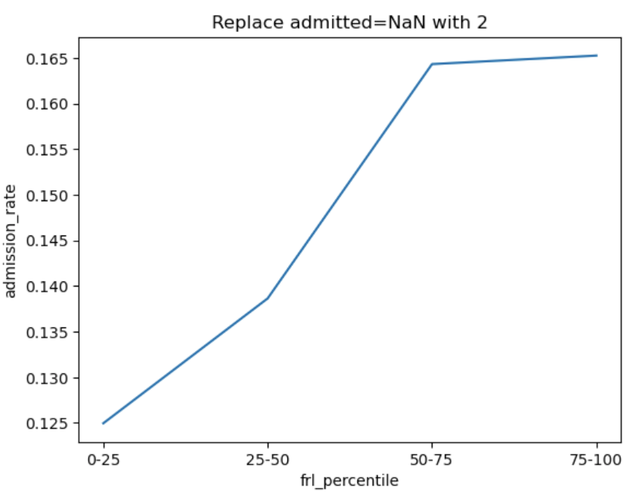
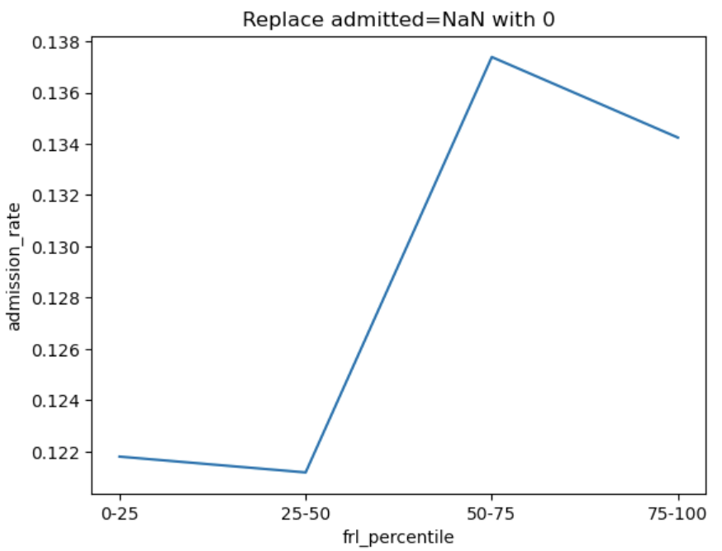
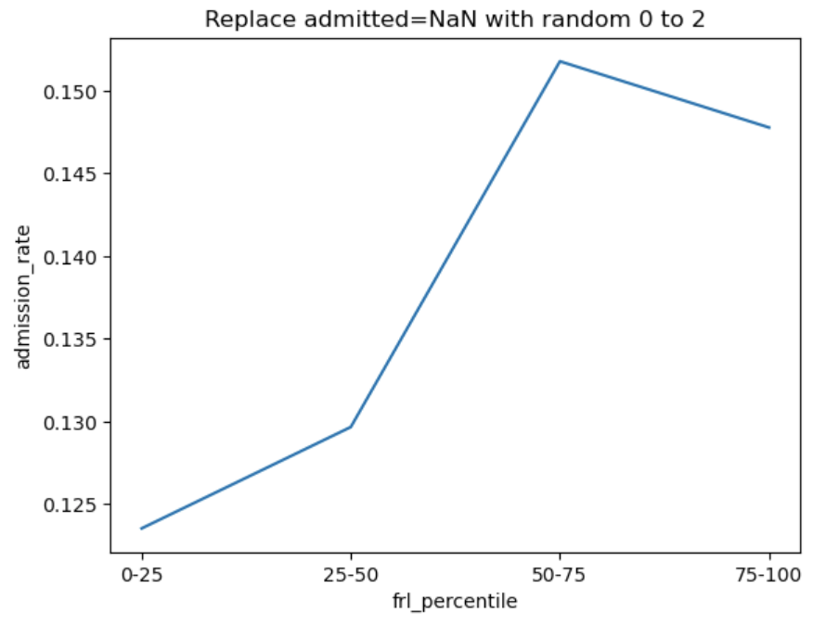
Four different ways to compute admission rates
We can compute average admission rates for all four ways we proposed and compare:
The pattern in admission rates is somewhat sensitive to our choice!

Slide 45
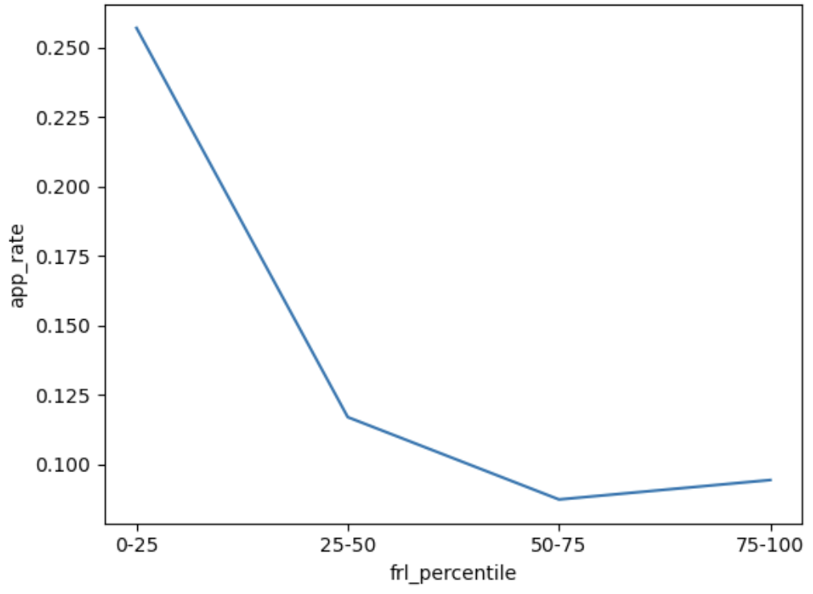
Admission rates have a different pattern than application rates
What's going on here? We’ll investigate next time!

Slide 46
Exploratory Data Analysis (EDA) III
LECTURE 4
Data 100/Data 200, Fall 2026 @ UC Berkeley
Ramesh Sridharan and Jeremy Sanchez
Content credit: Acknowledgments

